Slide 1


Autonomous Operations with ignio
ignio AIOps
Transforming Data-Center Operations

Slide 2

Agenda
Assignment1
Hands-on Lab2 – Capture Context - Blueprint from CMDB tool
Data Integration with ServiceNow CMDB - (Hands-on Lab2)

Slide 3
INSTRUCTIONS
Assignment1
Hands-on Lab2 – Capture Context - Blueprint from CMDB tool
Use this PPT to save screenshots of your assignment by replacing corresponding sample screenshots.
File name to use while submitting your assignment:
AIOPS_ILT_POU_AAAANN_Assignment1.pptx (or AIOPS_ ILT_POU_AAAANN _Assignment1.ods if you are using Open office),
where:
POU = Name of Parent Org Unit for your Training Batch. This is the top-level Org unit with name based on the start date of the training batch. e.g. something like 2022_01_10_N (if training starts on 10-Jan-2022)
AAAANN where AAAA = first four letters of your name and NN = a two digit number.
Thus, your filename would be something like AIOPS_ILT_2022_01_10_ravi11_Assignment1.pptx
Export the PPT into PDF format for assignment submission
You need to submit your assignment by uploading it into LMS for Assignment1.
For any queries, reach us at digitate.academy@digitate.com

Slide 4
1. Data Integration with ServiceNow CMDB
The screenshot in next slide should show the following
Grid View in the MAPS screen clearly showing the following
“your ou name” > DAPRDWIN01
The OSCPU, OSMemory, Drive and IIS entities on the right-hand side
Click the Grid View on MAPS screen after selecting your Org unit, then select the DAPRDWIN01 windows server entity
REPLACE screenshot in next slide with screenshot of your lab task as explained above

Slide 5
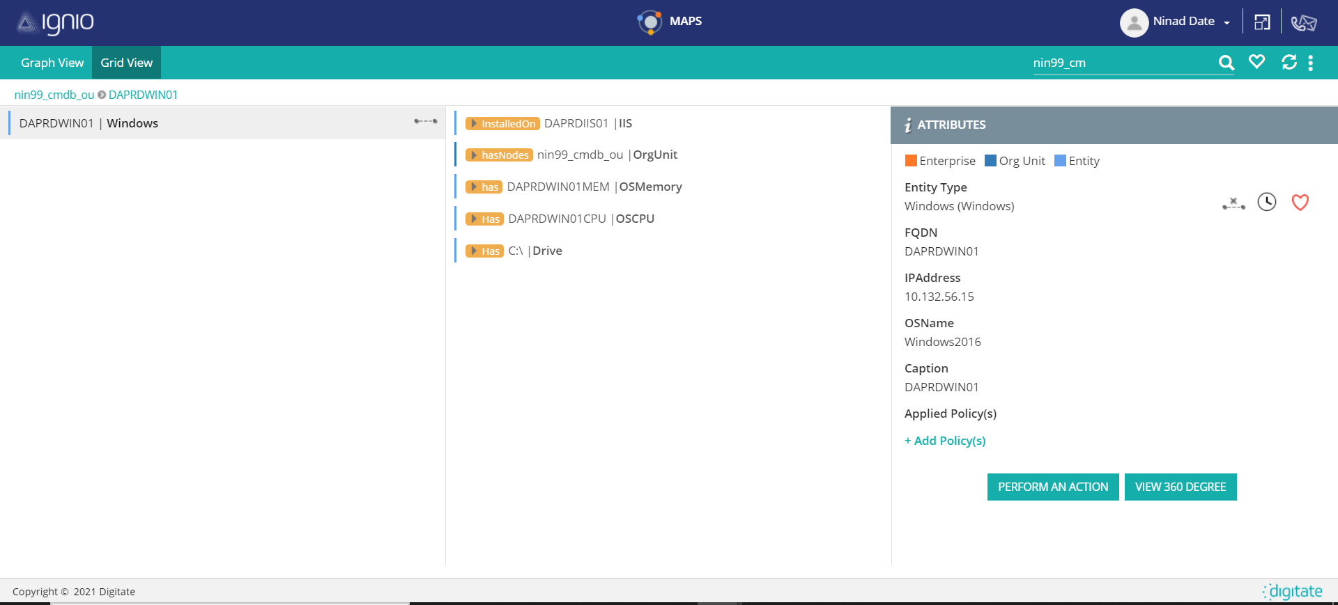

Slide 6

THANK YOU
AIOps
USER STORIES

